Slide 1
Slowly Changing Dimensions
Informatica PowerCenter – IICS_INT25AIAIICS003

Slide 2
What are Slowly Changing Dimensions?
SCD are a critical concept in Data warehousing .
To track and manage changes in dimension data over time.
They ensure historical accuracy and data integrity in DW.
Choosing the right SCD type depends on how much history must be retained.

Slide 3
Features of Slowly Changing Dimensions
Historical Tracking
Data Integrity
Type Based Classification
Versioning
Temporal Analysis

Slide 4
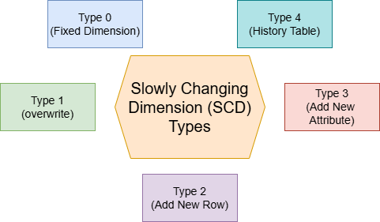

Slide 5
Types of Slowly Changing Dimensions
Type 0(Fixed Dimension):No changes allowed.
Type 1(Overwrite):New value replace the old one,no history maintained.
Type 2(Add New Row):A new record is added for every change in tracking history.
Type 3(Add New Attribute):A new column stores the previous value.
Type 4(History Table):Uses separate tables for current and historical data.

Slide 6
How to implement slowly changing dimensions in a data warehouse?
Step 1 - Initial Assessment
Evaluate Current State- Identify existing dimensions and their characteristics.
Identify Needs- Determine which dimensions require historical tracking.
Step 2 – Decide on SCD Types
Business Requirements: Consult stakeholders to determine the appropriate SCD type.
Implementation Preferences: Choose between flag columns,timestamps,or separate history tables.

Slide 7
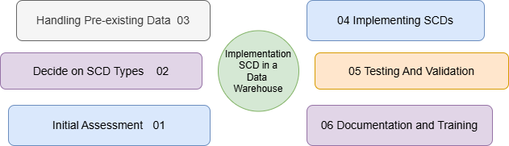

Slide 8
How to implement slowly changing dimensions in a data warehouse?
Step 3 - Handling Pre-existing Data
Historical Data Gaps:
1. Build Forward: start tracking from now,ignoring past gaps.
2.Reconstruct History: Attempt to fill in missing historical data cautiously.
Step 4 - Implementing SCDs
Schema Design: which types of SCDs we are going to use in Data warehousing.
ETL Processes: Update separate current and history tables.

Slide 9
How to implement slowly changing dimensions in a data warehouse?
Step 5 - Testing and Validation
Accuracy Checks: verify correct tracking of changes.
Data Quality Monitoring: Ensure historical records remain reliable.
Step 6 - Documentation and Training
Documentation: Maintain records of data models ,ETL processes , and history tracking rules.
Training: Educate data users on new tables and attributes.

Slide 10
How to implement slowly changing dimensions in a data warehouse?
Step 7 – Ongoing Maintenance
Regular Updates : Adapt SCD implementation as business needs change.
Performance Monitoring: Optimize performance for large datasets.

Slide 11
Conclusion
Enhances historical tracking
Supports better decision-making
Ensures the data consistency

Slide 12
Any Queries???

